Slide 1
1 meter of elevation head
1 meter
Reference elevation
1 meter of pressure head
1 meter of velocity head

Slide 2
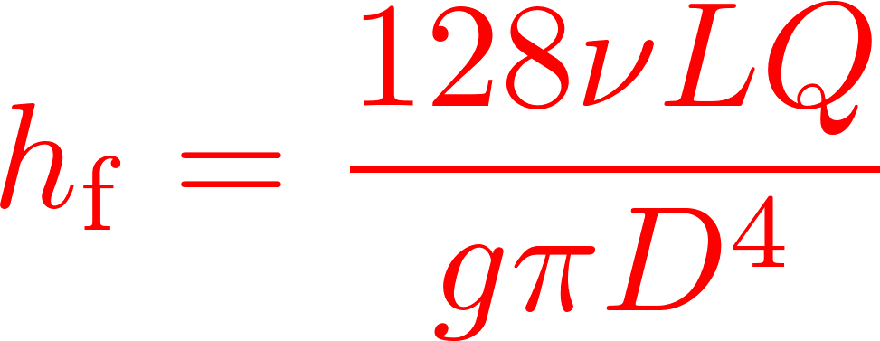


Calibrate at max flow

Slide 3
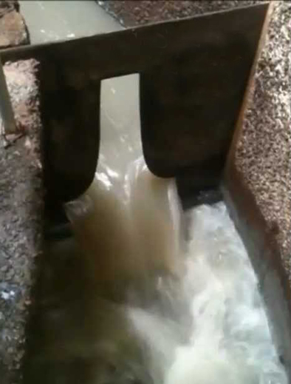
Sutro Weir
LFOM

Slide 4

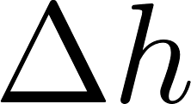


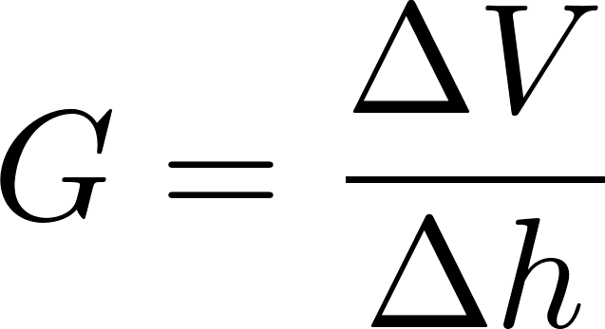

Slide 5



Slide 6


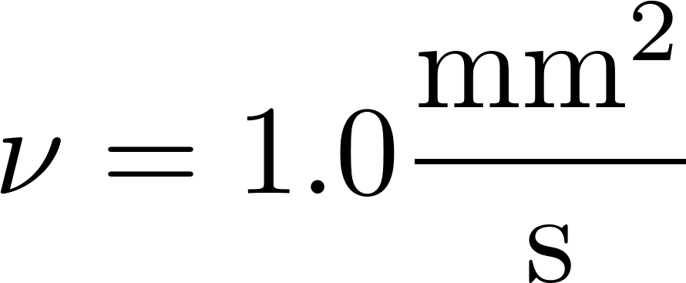




Slide 7
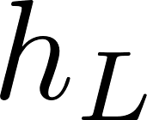
Small diameter tubing

Slide 8
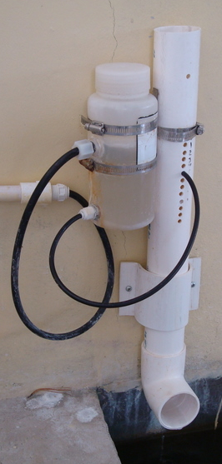
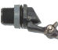
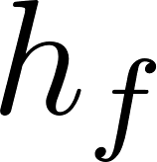
Air vent
Tube from the stock tank
Float valve
Holes to choose the dose
Flexible tube
Raw water
Rapid Mix
Orifice

Slide 9
V_{in}
V_{out}
A_{in}
x
A_{out}
in
out

Slide 10
Horizontal orifice
Vertical orifice

Slide 11
Overhead Tank
Constant head orifice
Overflow pipe
Pump

Slide 12

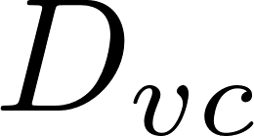
A
B

Slide 13
Pipe stub
Pipe coupling
Drain piping

Slide 14
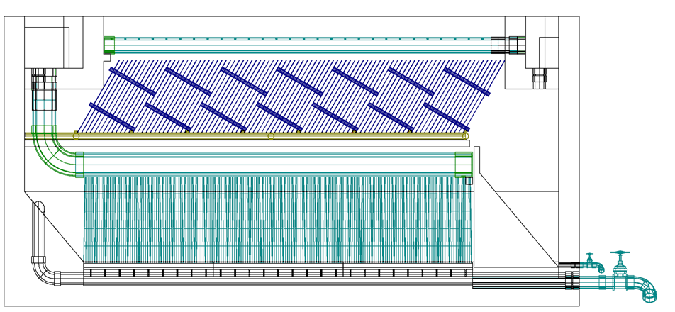
AutoCAD drawing of sedimentation tank, don’t worry if this is confusing!
You’ll learn about it in depth later on.
Sedimentation
tank drain

Slide 15


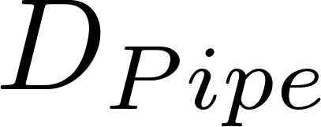


Slide 16

Float
Float
Orifice
Orifice
Transparent flexible tube
Transparent flexible tube

Slide 18
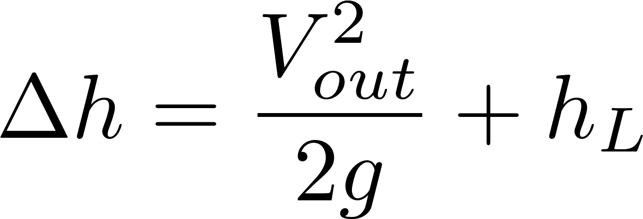






Simplified
energy equation
Just adding
K = 1 to the sum

Slide 19
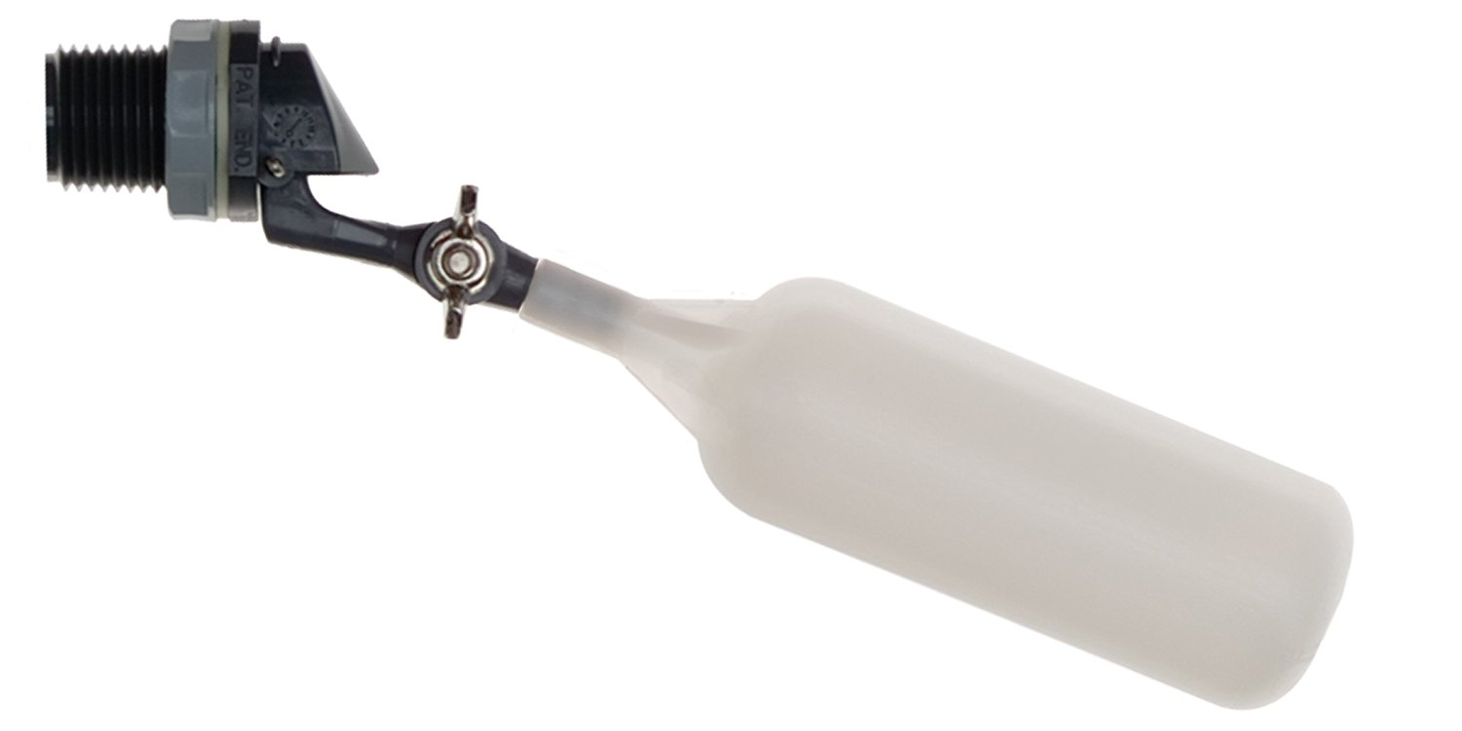
Flow of water
out of valve
Range of
motion of float
Float

Slide 20
C
B
A

Slide 21
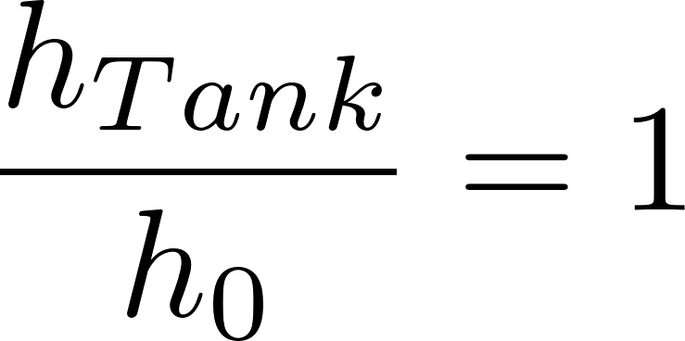
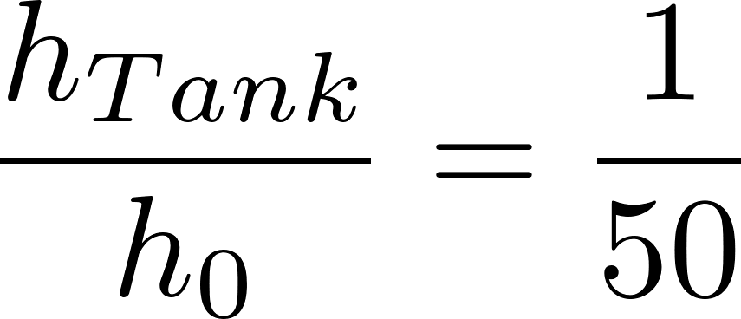
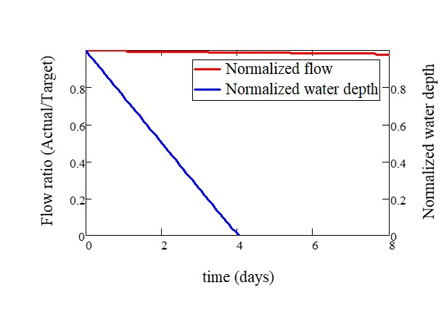
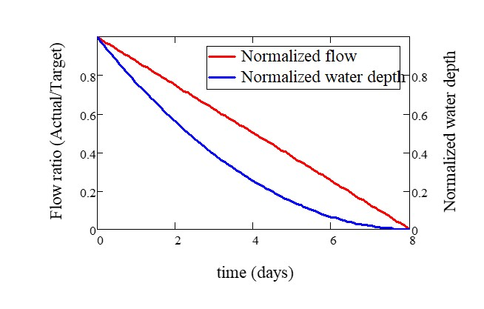

Slide 22
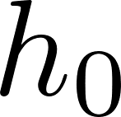
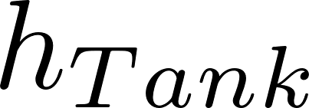
Tank
Valve
Water source pipe
Tank
Valve
Water source pipe

